Slide 1

Anime Recommender Model
Thien-An Bui

Slide 2

Problem Statement
Streaming platforms have become increasingly competitive and commonplace in today’s entertainment industry. Companies like Netflix and Crunchyroll both provide anime selections for users to stream and have sought ways to differentiate themselves to retain and grow their customer basis.
Our goal is to enhance the user experience on our anime streaming platform by implementing a robust anime recommender system. Many users on our platform have diverse preferences, and the vast catalog of animes available can be overwhelming. Users often struggle to discover animes aligned with their tastes and interests, leading to suboptimal engagement and potential dissatisfaction.
The current absence of a personalized recommendation system hinders our ability to provide tailored content suggestions, leading to missed opportunities for user retention and increased platform utilization. Therefore, the challenge at hand is to design and implement an anime recommender model that leverages user preferences, historical interactions, and collaborative filtering techniques to deliver accurate and personalized anime recommendations.
By addressing this challenge, our aim is to create a seamless and enjoyable user experience, increase user engagement, and foster a stronger connection between users and our platform. Through the successful implementation of the recommender system, we anticipate an improvement in user satisfaction, longer session durations, and a higher likelihood of users discovering animes that resonate with their preferences.

Slide 3
Assumptions / Hypotheses
All user profiles have at least one favorited anime.
We believe that a combination of user-item collaborative filtering will be more effective than using item-item or user-user filtering alone.

Slide 4
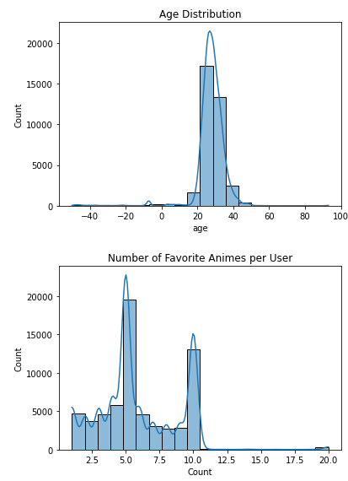
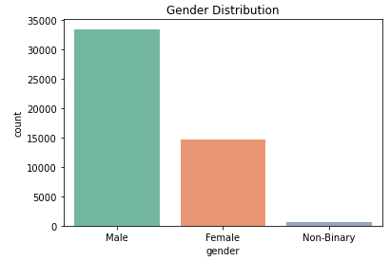
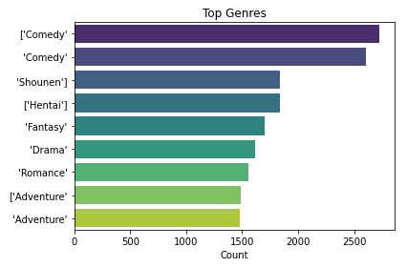
Exploratory Data Analysis
The vast majority of user profiles are young adults between the age of 20-40 and are predominantly male.
Profiles typically have about 5 favorited animes.
There are a wide range of anime genres available in the dataset, with comedy and shounen (young male) leading the charts.

Slide 5
Feature Engineering
We removed profiles with no animes in their favorites list.
We made a new dataset that contains each user profile’s UID number and dummy variables for each anime.
Profiles with a given anime favorited would return a value of 1 in the associated column, and 0 otherwise.

Slide 6
Proposed Model
We calculate the cosine similarity between the target user and all other users in the dataset, considering their anime-watching history using their favorited animes. This similarity score quantifies the likeness between users based on their anime preferences.
We identify the top 5 most similar users to the target user using the computed cosine similarity scores.
Recommendation scores are calculated for each user-anime pair, incorporating both user preferences and similarity scores.
We sum the recommendation scores across similar users for each anime, effectively combining the collaborative filtering approach with the user's own preferences.
Animes already watched by the target user are excluded from the recommendation list to. ensure that we are not recommending shows that the user has already seen.

Slide 7
Testing for Overfitting
We ran the algorithm on a user profile with a vastly different composition than the original test profile, which was a male user with a variety of genres.
This overfitting test was conducted on a female account with favorited shows trending heavily towards romance and female-oriented genres.
The recommender did suggest titles that were relevant to the user profile, but also included shows that fall outside of the user’s favorited genres. These outlier recommendations tended to be male-oriented, mainstream/popular shows.

Slide 8
Results
The model strikes a balance between user-specific preferences and broader trends in the user community, resulting in a set of recommendations tailored to enhance user satisfaction and engagement.
The model performs well for male user profiles.
The model does recommend titles relevant for female profiles, but also includes popular male-oriented shows as well.

Slide 9
Future Work
We can extend the capabilities of our recommender model to determine what animes we should consider adding to our offering, based on our viewer demographic and preferential distributions.
The model can be further improved by layering demographical information (such as age or gender) onto user profiles. This adds additional dimensions in which profiles can be compared to each other and lead to better recommendations.
Weights should be assigned when using user-user collaborative filtering. This is largely because certain subsets (e.g. male vs. female users) tend to watch different genres – the recommender should not deviate too far from the user’s preferences.

